Slide 1
UNIT 5
Counter
Synchronous – Asynchronous Counter
MOD Counter
Shift Register
Ring Counter
Johnson Counter

Slide 2
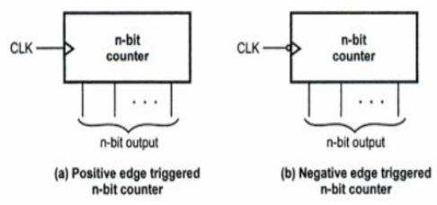
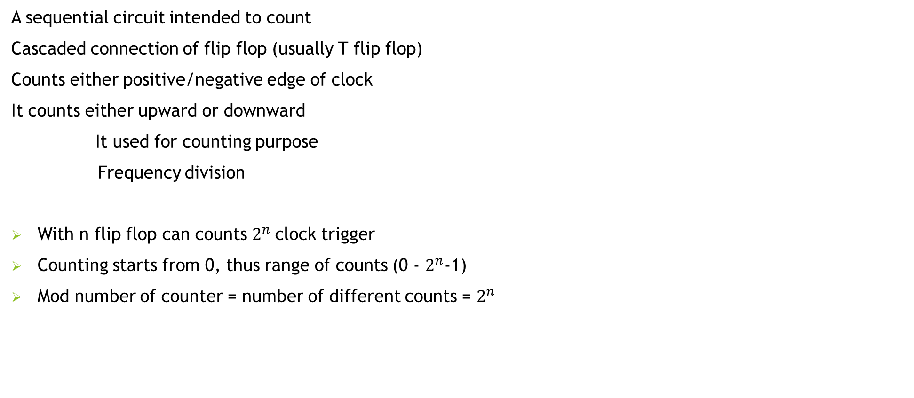
Counter
A sequential circuit intended to count
Cascaded connection of flip flop (usually T flip flop)
Counts either positive/negative edge of clock
It counts either upward or downward
It used for counting purpose
Frequency division
With n flip flop can counts $2^{n}$clock trigger
Counting starts from 0, thus range of counts (0 - $2^{n}$-1)
Mod number of counter = number of different counts = $2^{n}$

Slide 3
QUIZ TIME
How many FF requires to design MOD 16 counter
2
4
8
16

Slide 4
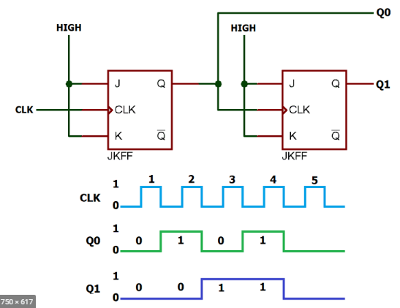
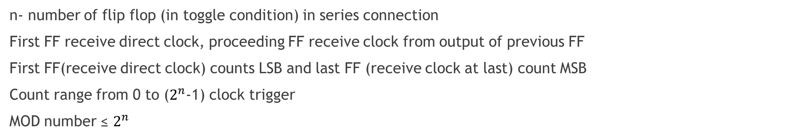
Asynchronous Counter / Ripple Counter
n- number of flip flop (in toggle condition) in series connection
First FF receive direct clock, proceeding FF receive clock from output of previous FF
First FF(receive direct clock) counts LSB and last FF (receive clock at last) count MSB
Count range from 0 to ($2^{n}$-1) clock trigger
MOD number ≤ $2^{n}$
2- bit Asynchronous Counter

Slide 5
QUIZ Time
In Asynchronous counter first FF receive direct clock and other from output of previous FF
A TRUE
B FALSE

Slide 6
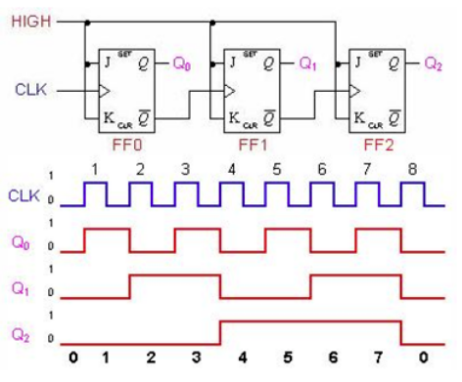
3- bit Asynchronous Counter

Slide 7
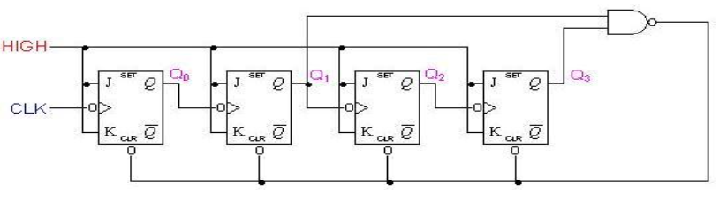
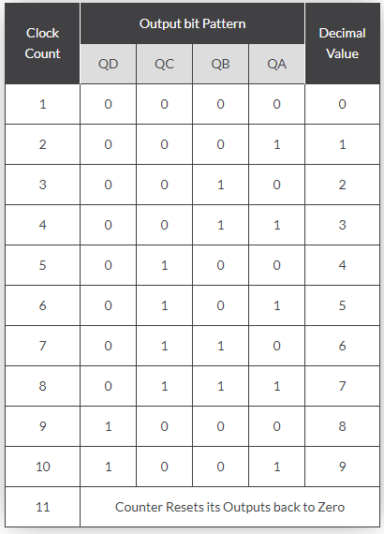
MOD 10 / Decade/BCD Asynchronous Counter
NAND gate clear each
FF at count 1010

Slide 8
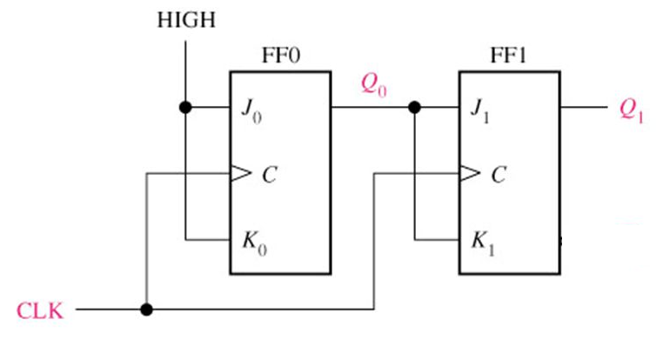
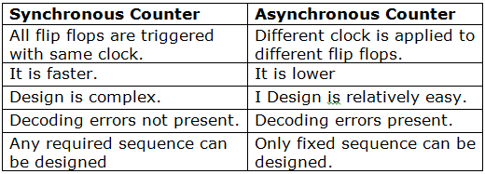
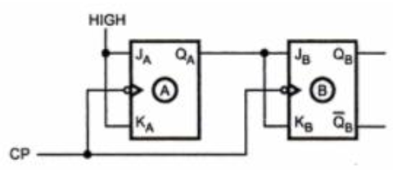
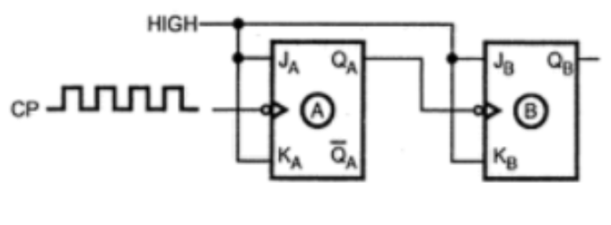
Synchronous Counter
Clock input of all flip-flops clocked together
Each FF toggle simultaneously
Q output acts as data input of next FF

Slide 9
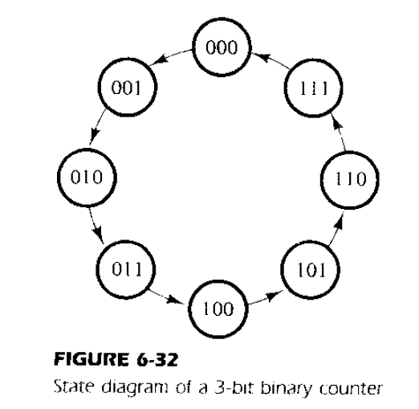
Binary Counter - Analysis

Slide 10
Counter Design
Observing the state diagram, we need three Flip flops.
3 FFs with given variables designations A2, A1, A0.
Constructed using the T-FFs.
Deriving the excitation table for the counter.
T-inputs of FFs of counter is derived from the excitation table of T-FF.
From the state diagram of Fig 6.32, the table showing the present state and the next state can be filled.

Slide 11
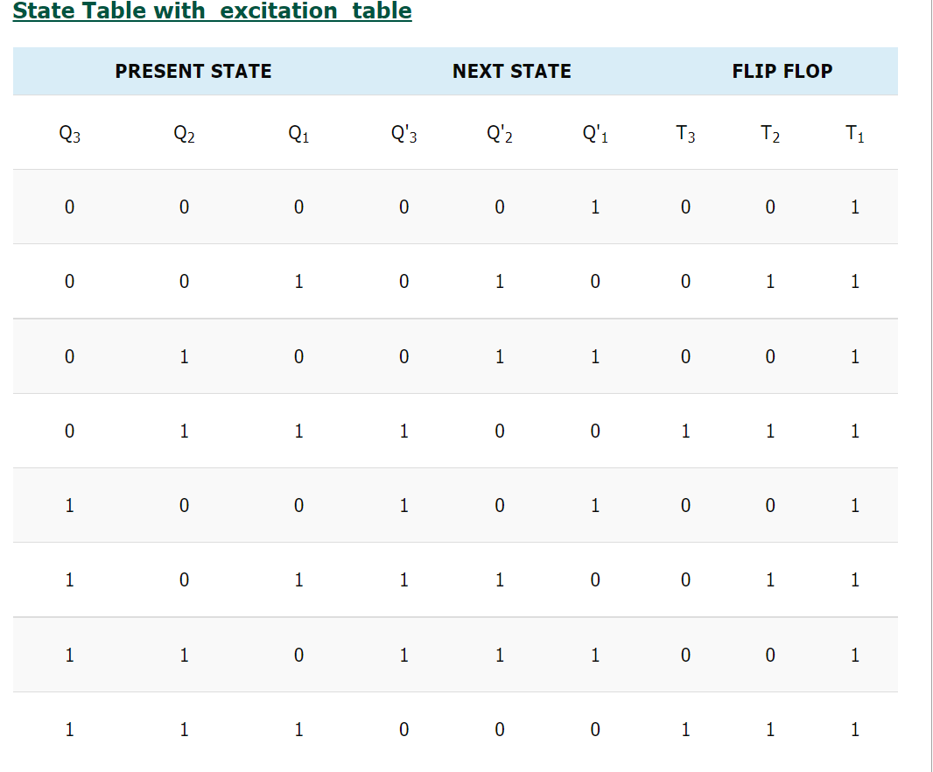
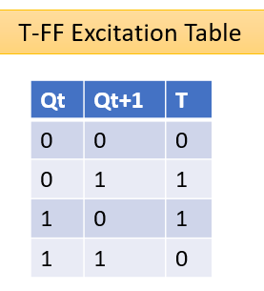
Excitation Table for 3-bit Counter

Slide 12
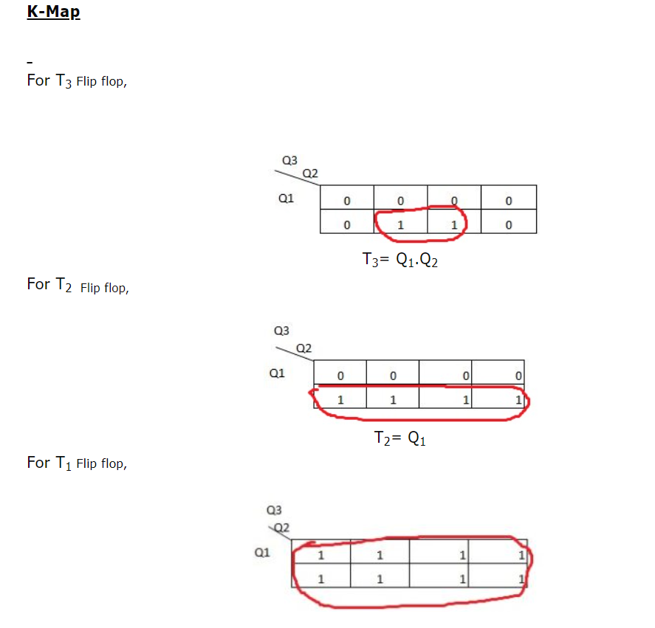
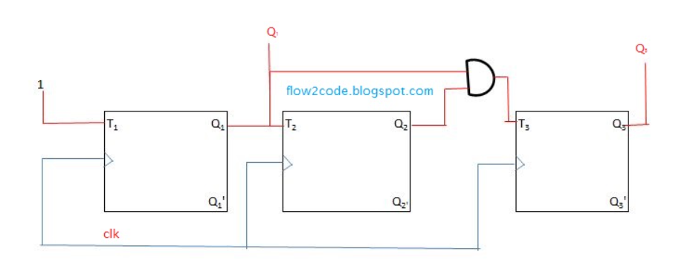


Slide 13
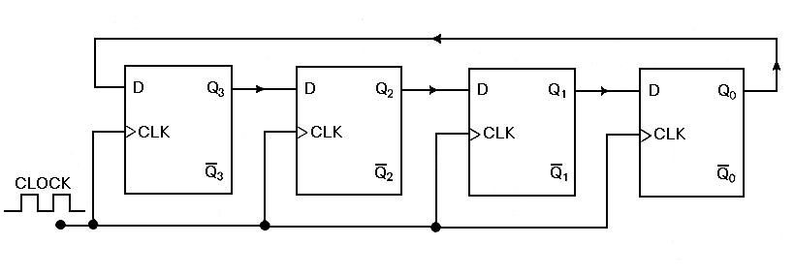
Ring counters are implemented using shift registers. It is essentially a circulating shift register connected so that the last flip-flop shifts its value into the first flip-flop. There is usually only a single 1 circulating in the register, as long as clock pulses are applied. (Starts 1000->0100->0010->0001 repeat)
Ring Counter

Slide 14
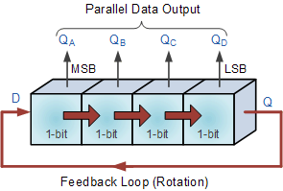
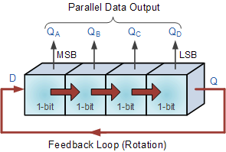
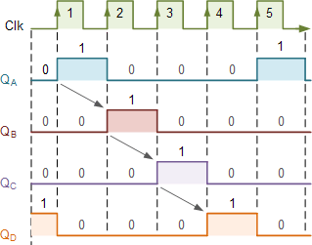

Slide 15
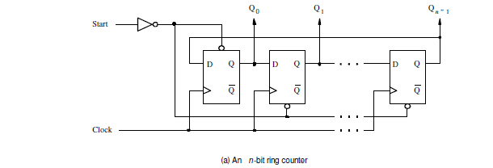
Start control signal, which presets the left-most flip-flop to 1 and clears the others to 0.

Slide 16
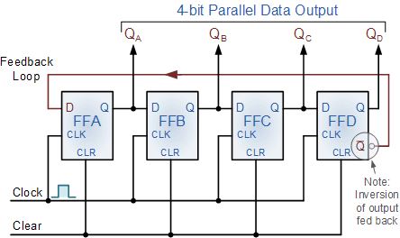
Johnson Counter
The Johnson counter, also known as the twisted-ring counter, is exactly the same as the ring counter except that the inverted output of the last flip-flop is connected to the input of the first flip-flop.

Slide 17
As well as counting or rotating data around a continuous loop, ring counters can also be used to detect or recognize various patterns or number values within a set of data. By connecting simple logic gates such as the AND or the OR gates to the outputs of the flip-flops the circuit can be made to detect a set number or value. Standard 2, 3 or 4-stage Johnson ring counters can also be used to divide the frequency of the clock signal by varying their feedback connections and divide-by-3 or divide-by-5 outputs are also available.
Clock Pulse No | FFA | FFB | FFC | FFD
0 | 0 | 0 | 0 | 0
1 | 1 | 0 | 0 | 0
2 | 1 | 1 | 0 | 0
3 | 1 | 1 | 1 | 0
4 | 1 | 1 | 1 | 1
5 | 0 | 1 | 1 | 1
6 | 0 | 0 | 1 | 1
7 | 0 | 0 | 0 | 1
Truth Table for a 4-bit Johnson Ring Counter

Slide 18
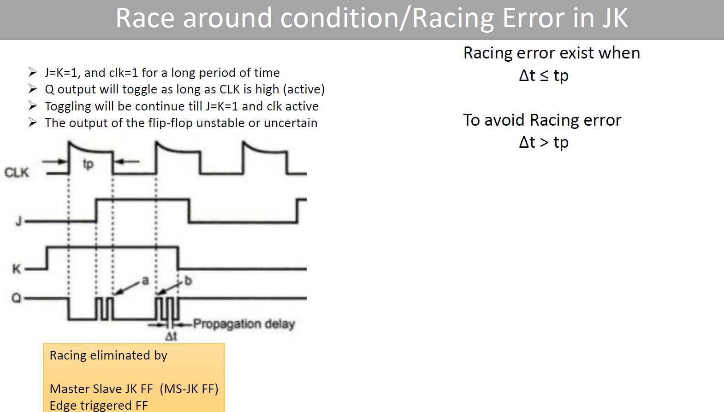

Slide 19
